Slide 1
Stats for Graduate Students: Lecture #6
Multiple regression – basics
Multicollinearity
Categorical variables in regression models
Linear regression vs. ANOVA
Mediation analysis (if time allows)

Slide 2
Where are we? Where are we going?
Class # | Class: Topics | Tutorial # | Tutorial: Topics
1 | Replication crisis in psychology Hypothesis testing: An intro; One-sample Z and t-tests | 1 | Intro to R I
 | (No class – elections) | 1b | Intro to R II: Basic tests, simulations
2 | Statistical errors I: Refresher Two-sample t-test (independent + paired) Beyond dichotomous inference | 2 | Assumption violation and statistical errors – simulations.
3 | Statistical errors II: How many findings are false?; power analysis One-way and two-way ANOVA | 3 | Power analysis in R One-way ANOVA in R
4 | Contrasts (Planned vs. posthoc) Statistical errors III: False-positive psychology | 4 | Contrasts False-positive psychology simulations
5 | ANOVAs: within-subject and beyond. Correlation, regression, intro to multiple regression | 5 | Repeated measures ANOVA Simple linear models in R
6 | Multiple regression I: Control variables, (Multi)collinearity, categorical predictors | 6 | Multiple regression in R I
7 | Multiple regression II: Interactions, centering & Transformation of variables, logistic models | 7 | Multiple regression in R II
 | Vacation |  | Vacation
8 | Mixed-effect models I: Fixed vs. random effects, significance testing | 8 | Mixed-effect models in R I
9 | Mixed-effect models II: Coding, interactions, centering & Transformations, Logistic LMM | 9 | Mixed-effect models in R II
10 | Mixed-effect models III: Determining random effect structure | 10 | Mixed-effect models in R III
11 | Summary so far Introduction to multivariate, non-parametric, and Bayesian inference | 11 | Multiple DVs (multivariate)
12 | Student presentations | 12 | Multiple DVs (multivariate)
13 | Student presentations *two weeks into break
More familiar (but: more advanced discussions,
Must-read papers,
R inc. simulations)
More novel

Slide 3
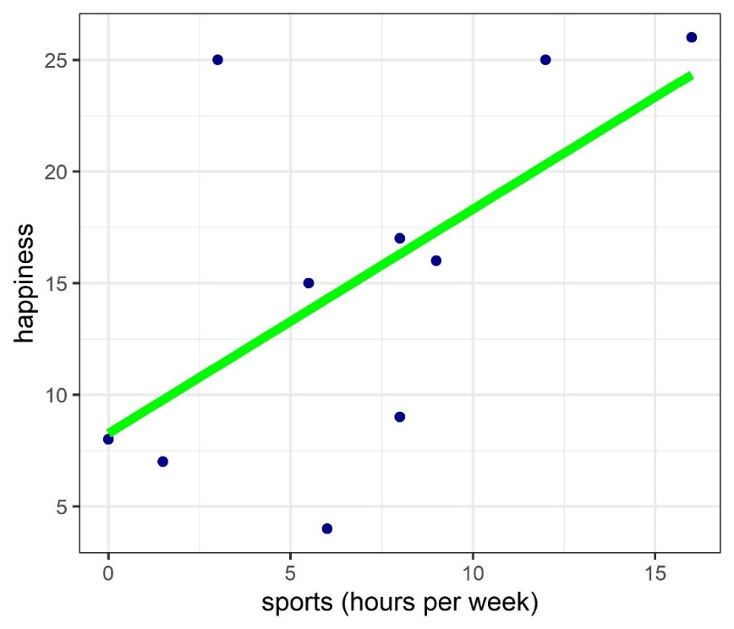
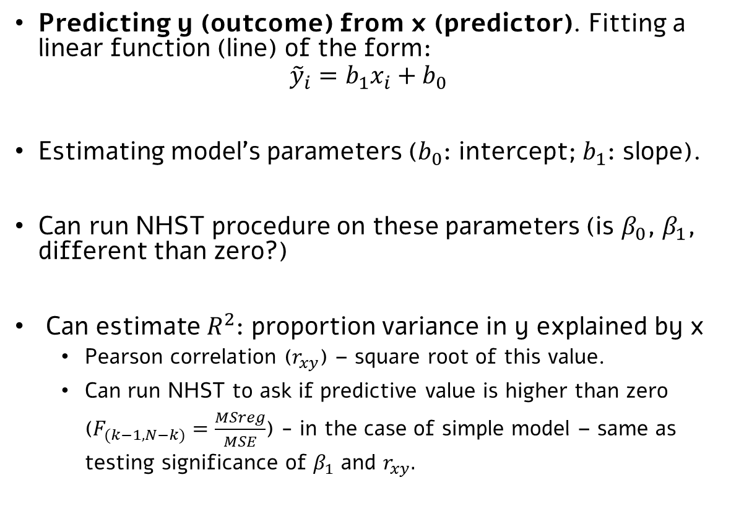
Reminder: Simple linear regression
Predicting y (outcome) from x (predictor). Fitting a linear function (line) of the form:
$${\tilde{y}}_{i}=b_{1}x_{i}+b_{0}$$
Estimating model’s parameters ($b_{0}$: intercept; $b_{1}$: slope).
Can run NHST procedure on these parameters (is $β_{0}$, $β_{1}$, different than zero?)
Can estimate $R^{2}$: proportion variance in y explained by x
Pearson correlation ($r_{xy}$) – square root of this value.
Can run NHST to ask if predictive value is higher than zero ($F_{(k−1, N−k)}=\frac{MSreg}{MSE}$) - in the case of simple model – same as testing significance of $β_{1}$ and $r_{xy}.$

Slide 4
Multiple Regression Adding more predictors to a model

Slide 5
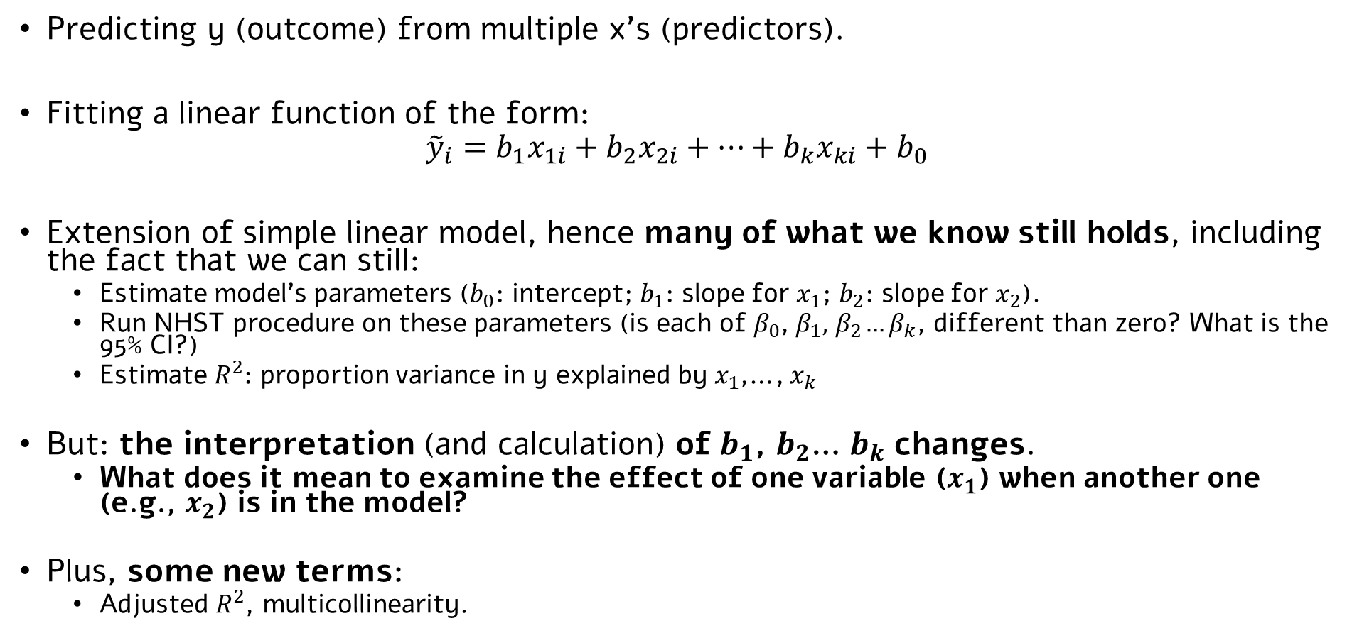
Multiple regression: More than one predictor
Predicting y (outcome) from multiple x’s (predictors).
Fitting a linear function of the form:
$${\tilde{y}}_{i}=b_{1}x_{1i}+b_{2}x_{2i}+…+b_{k}x_{ki}+b_{0}$$
Extension of simple linear model, hence many of what we know still holds, including the fact that we can still:
Estimate model’s parameters ($b_{0}$: intercept; $b_{1}$: slope for $x_{1}$; $b_{2}$: slope for $x_{2}$).
Run NHST procedure on these parameters (is each of $β_{0}$, $β_{1},{ β}_{2}…β_{k}$, different than zero? What is the 95% CI?)
Estimate $R^{2}$: proportion variance in y explained by $x_{1}$,…, $x_{k}$
But: the interpretation (and calculation) of $b_{1}$, $b_{2}$… $b_{k}$ changes.
What does it mean to examine the effect of one variable ($x_{1}$) when another one (e.g., $x_{2}$) is in the model?
Plus, some new terms:
Adjusted $R^{2}$, multicollinearity.

Slide 6
When to use multiple regression?
A very common procedure, with many applications.
Two common cases in Psychology:
Examining the effect of >1 independent variables on a (continuous) outcome
We are interested not only in the effect of, e.g., exercise on happiness levels, but also in the effects of, e.g., hours spent with friends and family, consumption of fruit and vegetables …
Controlling for the effect of another (control, nuisance) variable.
We are interested in the effect of exercise on happiness levels. But we also know that those who exercise more spend more time in the sun, which is a variable related to happiness level. Say that in this study, we don’t care about the link between sun exposure and happiness; we want to ‘partial it out’, clean it, and look at the ‘pure’ effect of exercise time on happiness.

Slide 7
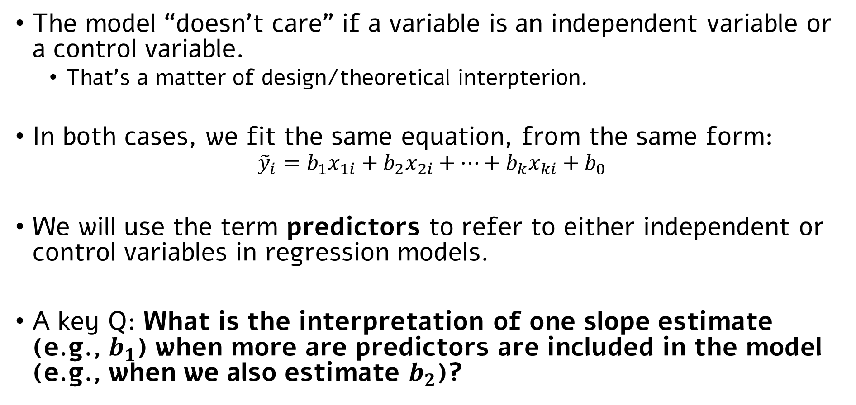
In both cases, the math is the same
The model “doesn’t care” if a variable is an independent variable or a control variable.
That’s a matter of design/theoretical interpterion.
In both cases, we fit the same equation, from the same form:
$${\tilde{y}}_{i}=b_{1}x_{1i}+b_{2}x_{2i}+…+b_{k}x_{ki}+b_{0}$$
We will use the term predictors to refer to either independent or control variables in regression models.
A key Q: What is the interpretation of one slope estimate (e.g., $b_{1}$) when more are predictors are included in the model (e.g., when we also estimate $b_{2}$)?

Slide 8
Multiple Predictors: Intuition
In a simple linear regression (i.e., one predictor; $y=b_{1}∗x_{1}+b0$):
Happiness (y)
Exercise hours (x1)
The part explained by x1 in y
Used to compute b₁, as well as the model’s R²

Slide 9
Multiple Predictors: Intuition
In a multiple linear regression (e.g., two predictors; $y=b_{1}∗x_{1}+b_{2}∗x_{2}+b0$):
Happiness (y)
The part explained by x1 in y, “controlling“ for or “partialling out” x2.
Used to compute b₁.
The part explained by x2 in y, “controlling“ for or “partialling out” x1.
Used to compute b₂.
Exercise hours (x1)
Hours in sun (x2)

Slide 10
Multiple Predictors: Intuition
In a multiple linear regression (e.g., two predictors; $y=b_{1}∗x_{1}+b_{2}∗x_{2}+b0$):
Happiness (y)
The part explained by x1 AND x2 in y.
Used to compute total R² (and SSreg) of model.
Exercise hours (x1)
Hours in sun (x2)

Slide 11
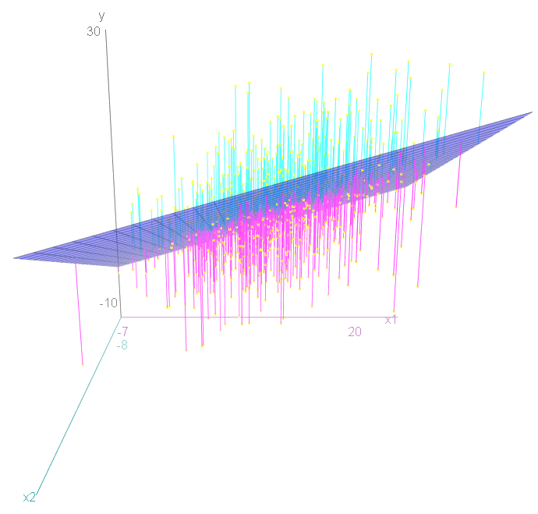
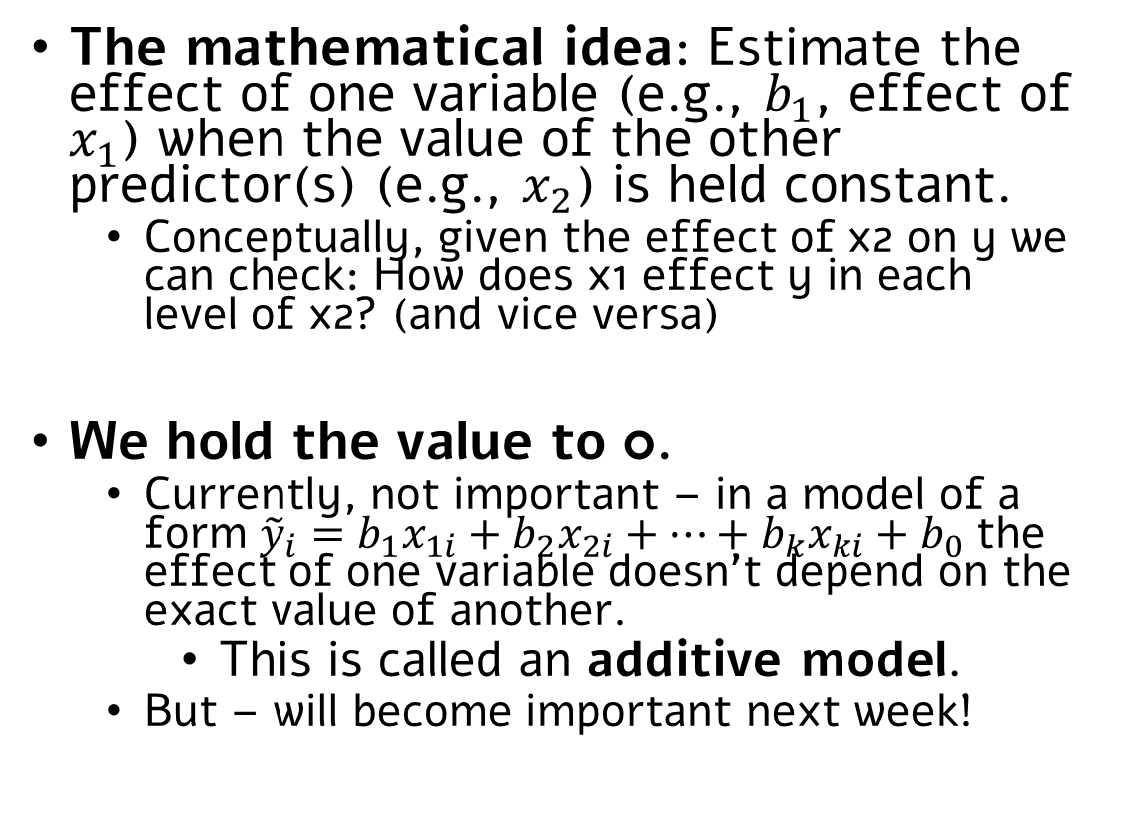
The mathematical idea: Estimating the effect of x1 when holding x2 constant
The mathematical idea: Estimate the effect of one variable (e.g., $b_{1}$, effect of $x_{1}$) when the value of the other predictor(s) (e.g., $x_{2}$) is held constant.
Conceptually, given the effect of x2 on y we can check: How does x1 effect y in each level of x2? (and vice versa)
We hold the value to 0.
Currently, not important – in a model of a form ${\tilde{y}}_{i}=b_{1}x_{1i}+b_{2}x_{2i}+…+b_{k}x_{ki}+b_{0}$ the effect of one variable doesn’t depend on the exact value of another.
This is called an additive model.
But – will become important next week!

Slide 12
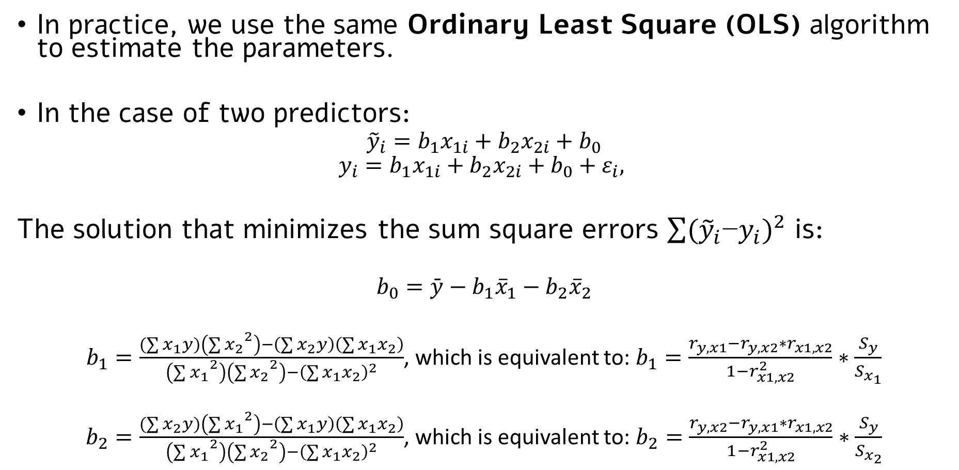
The mathematical idea: Estimating the effect of x1 when holding x2 constant
In practice, we use the same Ordinary Least Square (OLS) algorithm to estimate the parameters.
In the case of two predictors:
$${\tilde{y}}_{i}=b_{1}x_{1i}+b_{2}x_{2i}+b_{0}$$
$$y_{i}=b_{1}x_{1i}+b_{2}x_{2i}+b_{0}+ε_{i},$$
The solution that minimizes the sum square errors ${\sum{({\tilde{y}}_{i}\text{−}y_{i}})}^{2}$ is:
$$b_{0}=\bar{y}−b_{1}{\overline{x}}_{1}−b_{2}{\overline{x}}_{2}$$
$b_{1}=\frac{(\sum{x_{1}y)\left({\sum{x_{2}}}^{2}\right)−\left(\sum{x_{2}y}\right)\left(\sum{x_{1}x_{2}}\right)}}{\left({\sum{x_{1}}}^{2}\right)\left({\sum{x_{2}}}^{2}\right)−{\left(\sum{x_{1}x_{2}}\right)}^{2}}$, which is equivalent to: $b_{1}=\frac{r_{y,x1}−r_{y,x2}∗r_{x1,x2}}{1−r_{x1,x2}^{2}}∗\frac{S_{y}}{S_{x_{1}}}$
$b_{2}=\frac{(\sum{x_{2}y)\left({\sum{x_{1}}}^{2}\right)−\left(\sum{x_{1}y}\right)\left(\sum{x_{1}x_{2}}\right)}}{\left({\sum{x_{1}}}^{2}\right)\left({\sum{x_{2}}}^{2}\right)−{\left(\sum{x_{1}x_{2}}\right)}^{2}}$, which is equivalent to: $b_{2}=\frac{r_{y,x2}−r_{y,x1}∗r_{x1,x2}}{1−r_{x1,x2}^{2}}∗\frac{S_{y}}{S_{x_{2}}}$

Slide 13
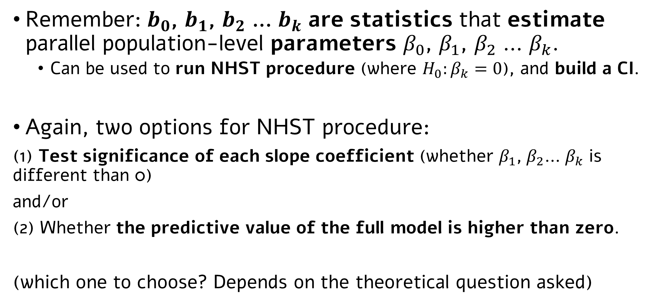
Significance testing in multiple regression
Remember: $b_{0}$, $b_{1}$, $b_{2}$ … $b_{k}$ are statistics that estimate parallel population-level parameters $β_{0}$, $β_{1}$, $β_{2}$ … $β_{k}$.
Can be used to run NHST procedure (where $H_{0}:β_{k}=0$), and build a CI.
Again, two options for NHST procedure:
(1) Test significance of each slope coefficient (whether $β_{1}$, $β_{2}$… $β_{k}$ is different than 0)
and/or
(2) Whether the predictive value of the full model is higher than zero.
(which one to choose? Depends on the theoretical question asked)

Slide 14
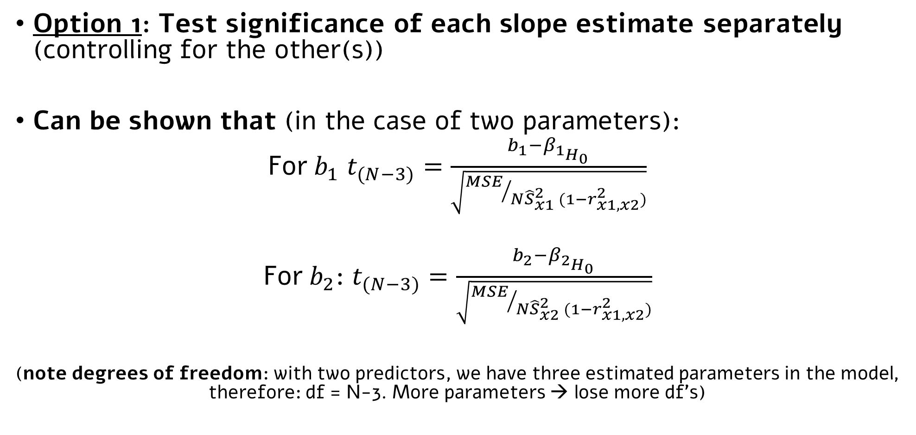
Significance testing in multiple regression
Option 1: Test significance of each slope estimate separately (controlling for the other(s))
Can be shown that (in the case of two parameters):
For $b_{1}$ $t_{(N−3)}=\frac{b_{1}−β_{1_{H_{0}}}}{\sqrt{{MSE}/{N{\hat{S}}_{x1}^{2} (1−r_{x1,x2}^{2})}}}$
For $b_{2}$: $t_{(N−3)}=\frac{b_{2}−β_{2_{H_{0}}}}{\sqrt{{MSE}/{N{\hat{S}}_{x2}^{2} (1−r_{x1,x2}^{2})}}}$
(note degrees of freedom: with two predictors, we have three estimated parameters in the model, therefore: df = N-3. More parameters → lose more df’s)

Slide 15
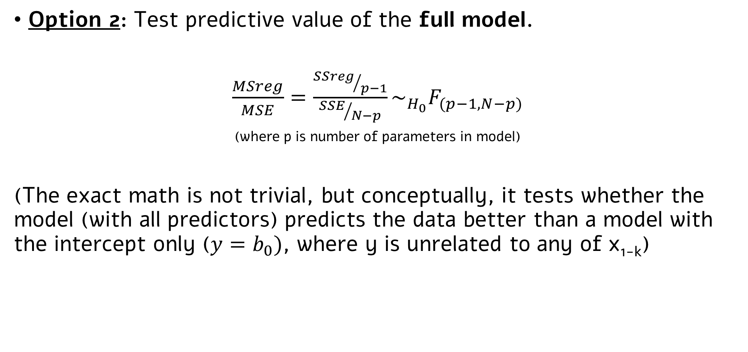
Significance testing in multiple regression
Option 2: Test predictive value of the full model.
$\frac{MSreg}{MSE}=\frac{{SSreg}/{p−1}}{{SSE}/{N−p}}\sim _{H_{0}}F_{(p−1, N−p)}$
(where p is number of parameters in model)
(The exact math is not trivial, but conceptually, it tests whether the model (with all predictors) predicts the data better than a model with the intercept only ($y=b_{0})$, where y is unrelated to any of x_{1-k})

Slide 16
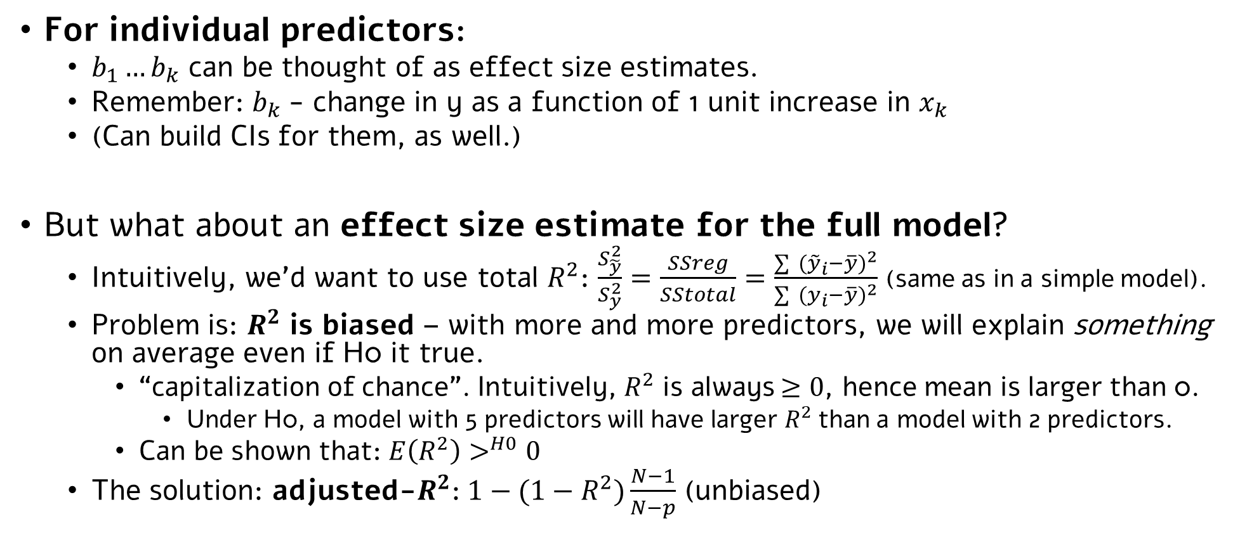
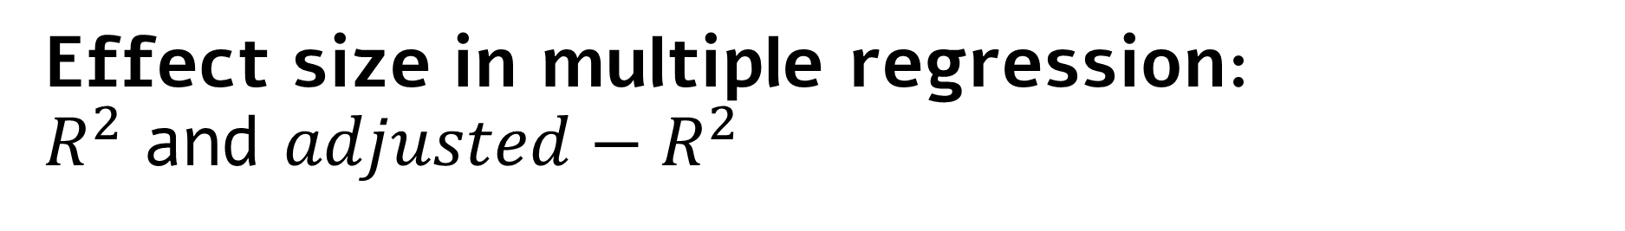
Effect size in multiple regression: $R^{2}$ and $adjusted−R^{2}$
For individual predictors:
$b_{1}…b_{k}$ can be thought of as effect size estimates.
Remember: $b_{k}$- change in y as a function of 1 unit increase in $x_{k}$
(Can build CIs for them, as well.)
But what about an effect size estimate for the full model?
Intuitively, we’d want to use total $R^{2}$: $\frac{S_{\tilde{y}}^{2}}{S_{y}^{2}}=\frac{SSreg}{SStotal}=\frac{\sum{{ ({\tilde{y}}_{i}−\overline{y})}^{2}}}{\sum{{ (y_{i}−\overline{y})}^{2}}}$ (same as in a simple model).
Problem is: $R^{2}$ is biased – with more and more predictors, we will explain something on average even if H0 it true.
“capitalization of chance”. Intuitively, $R^{2}$ is always $≥0$, hence mean is larger than 0.
Under H0, a model with 5 predictors will have larger $R^{2}$than a model with 2 predictors.
Can be shown that: $E\left(R^{2}\right)>^{H0}0$
The solution: adjusted-$R^{2}$: $1−(1−R^{2})\frac{N−1}{N−p}$ (unbiased)

Slide 17
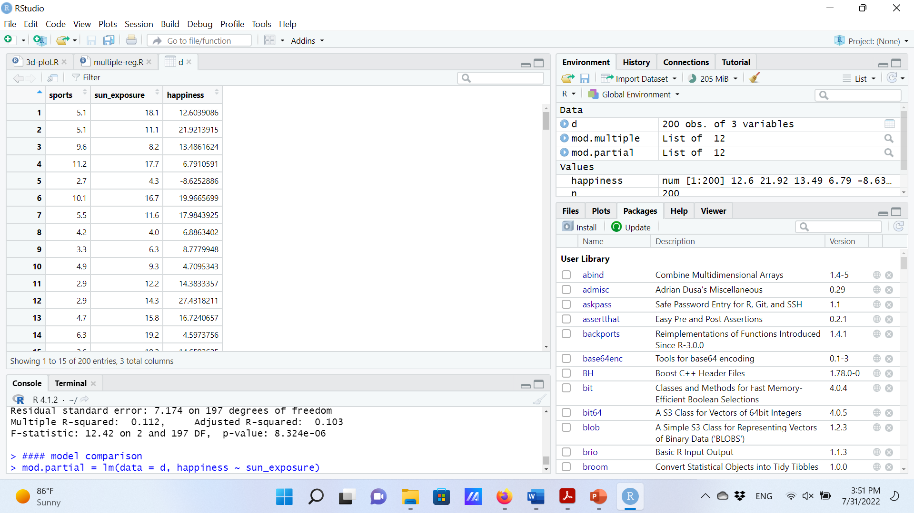
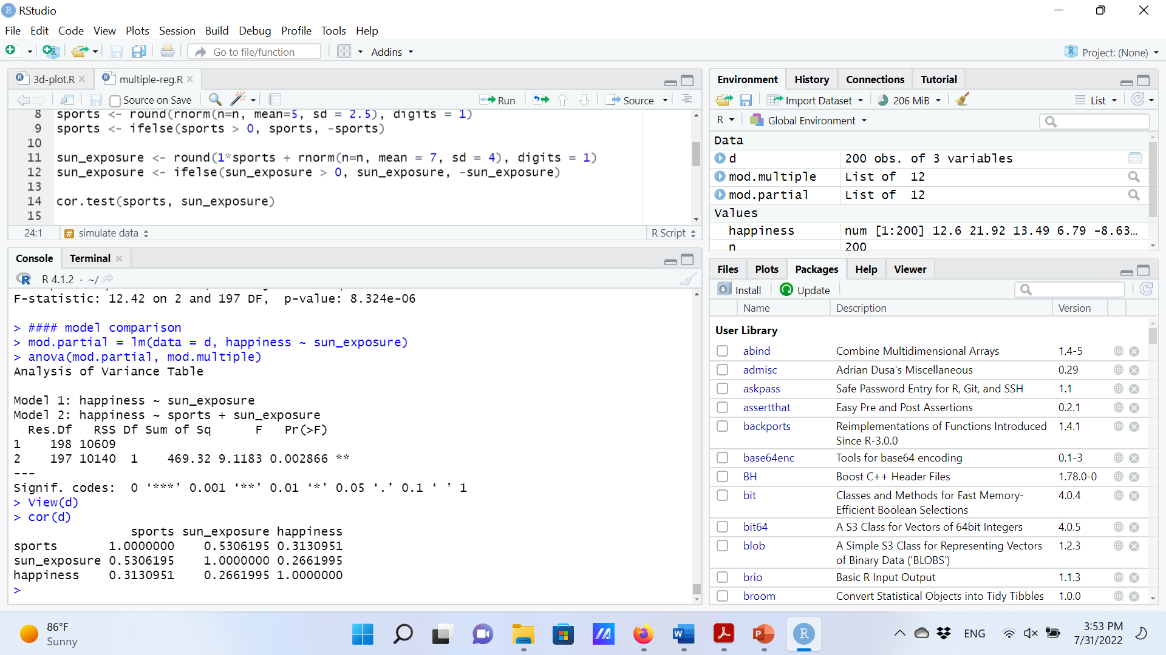
Multiple Regression in R
Before running the model, let’s look at the correlations between the three variables:
Our dataframe:
Notes:
Exercise hours is correlated with happiness, but it is also correlated with sun_exposure, so it’s hard to say whether it’s impact is unique or not.

Slide 18
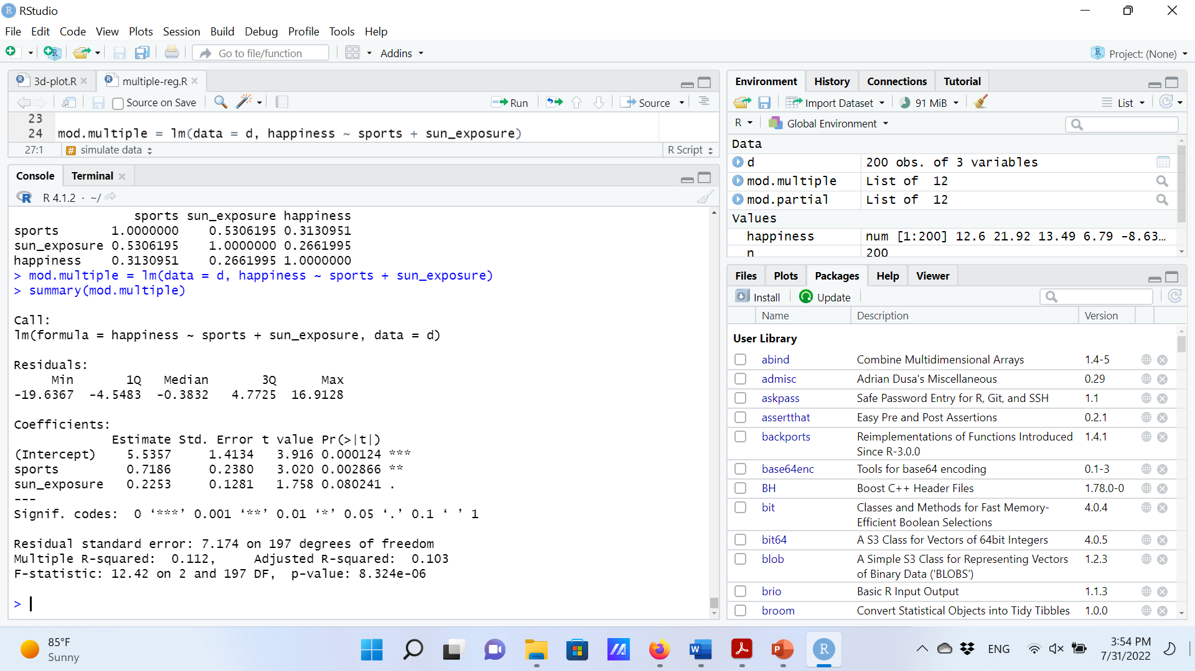
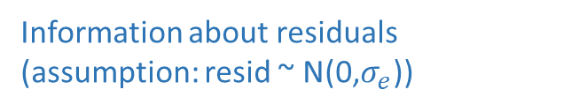
Multiple Regression in R
Information about residuals
(assumption: resid ~ N(0,$σ_{e}$))
Estimate, SE, t, and p values for b0 (intercept)
Estimate, SE, t, and p values for b1 (slope for exercise hours)
Estimate, SE, t, and p values for b2 (slope for sun exposure)
^{F test for the full model}
R²
Adjusted R²
Notes:
Exercise hours is correlated with happiness, but it is also correlated with sun_exposure, so it’s hard to say whether it’s impact is unique or not.

Slide 19
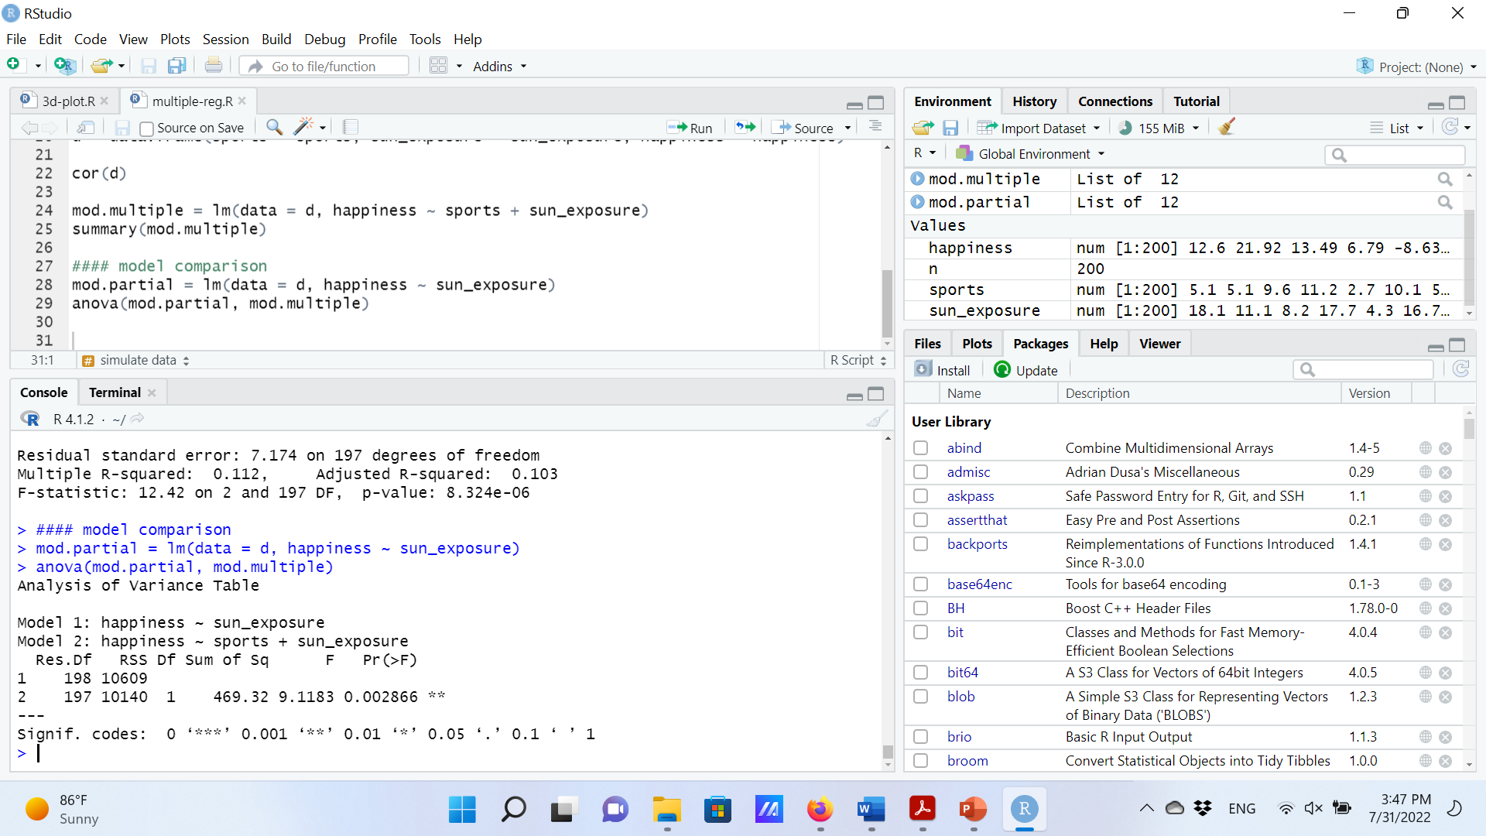
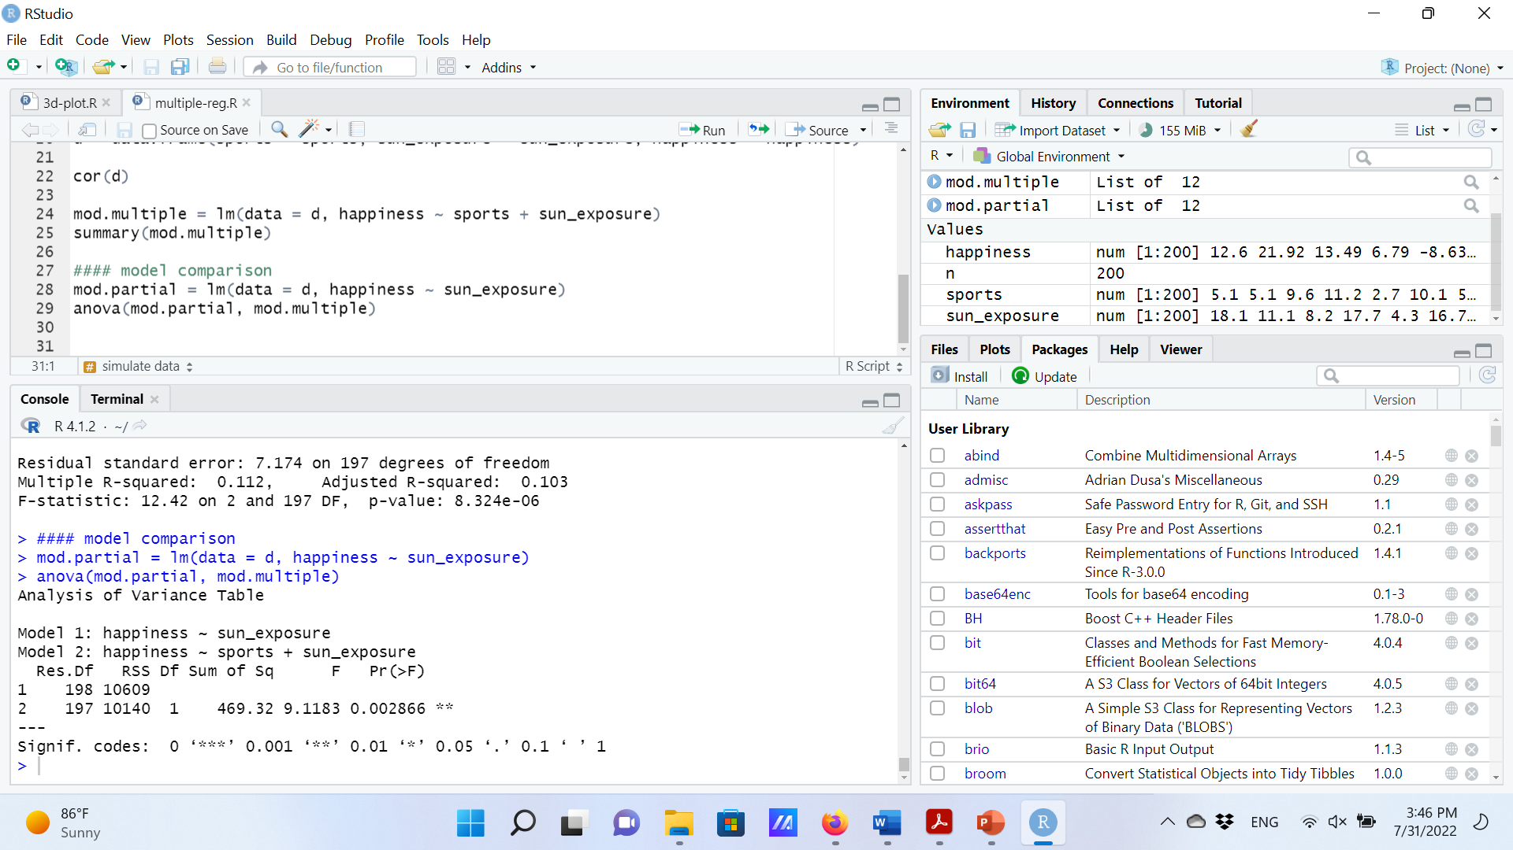
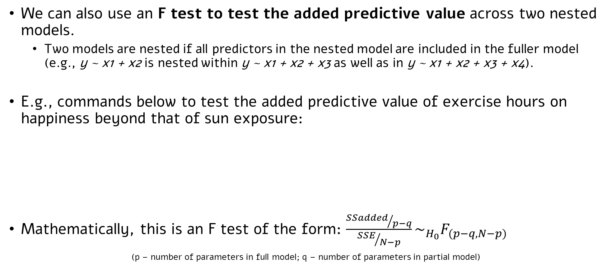
One more significance test
We can also use an F test to test the added predictive value across two nested models.
Two models are nested if all predictors in the nested model are included in the fuller model (e.g., y ~ x1 + x2 is nested within y ~ x1 + x2 + x3 as well as in y ~ x1 + x2 + x3 + x4).
E.g., commands below to test the added predictive value of exercise hours on happiness beyond that of sun exposure:
Mathematically, this is an F test of the form: $\frac{{SSadded}/{p−q}}{{SSE}/{N−p}}\sim _{H_{0}}F_{(p−q, N−p)}$
(p – number of parameters in full model; q – number of parameters in partial model)

Slide 20
One more significance test
In this case, the outcome of the test is equivalent to the outcome of testing the coefficient of exercise hours alone (see p-values in summary() and anova().
But, we can use this approach to test the added predictive value of more than one predictor at a time.
E.g., y ~ x1 vs. y ~ x1 + x2 + x3.
This will become really useful in about 15 slides.

Slide 21
Multicollinearity

Slide 22
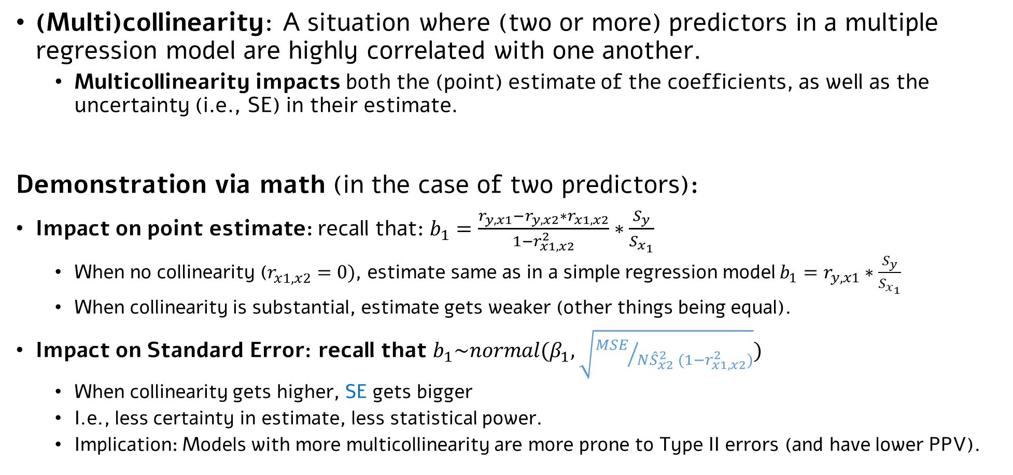
Multicollinearity in multiple regression
(Multi)collinearity: A situation where (two or more) predictors in a multiple regression model are highly correlated with one another.
Multicollinearity impacts both the (point) estimate of the coefficients, as well as the uncertainty (i.e., SE) in their estimate.
Demonstration via math (in the case of two predictors):
Impact on point estimate: recall that: $b_{1}=\frac{r_{y,x1}−r_{y,x2}∗r_{x1,x2}}{1−r_{x1,x2}^{2}}∗\frac{S_{y}}{S_{x_{1}}}$
When no collinearity ($r_{x1,x2}^{}=0)$, estimate same as in a simple regression model $b_{1}=r_{y,x1}∗\frac{S_{y}}{S_{x_{1}}}$
When collinearity is substantial, estimate gets weaker (other things being equal).
Impact on Standard Error: recall that $b_{1}\sim normal(β_{1},\sqrt{{MSE}/{N{\hat{S}}_{x2}^{2} (1−r_{x1,x2}^{2})}})$
When collinearity gets higher, SE gets bigger
I.e., less certainty in estimate, less statistical power.
Implication: Models with more multicollinearity are more prone to Type II errors (and have lower PPV).

Slide 23
Multicollinearity in multiple regression
Demonstration via intuitive depiction (in the case of two predictors):
No collinearity:
High collinearity:
Exercise hours (x1)
Hours in sun (x2)
Happiness (y)

Slide 24
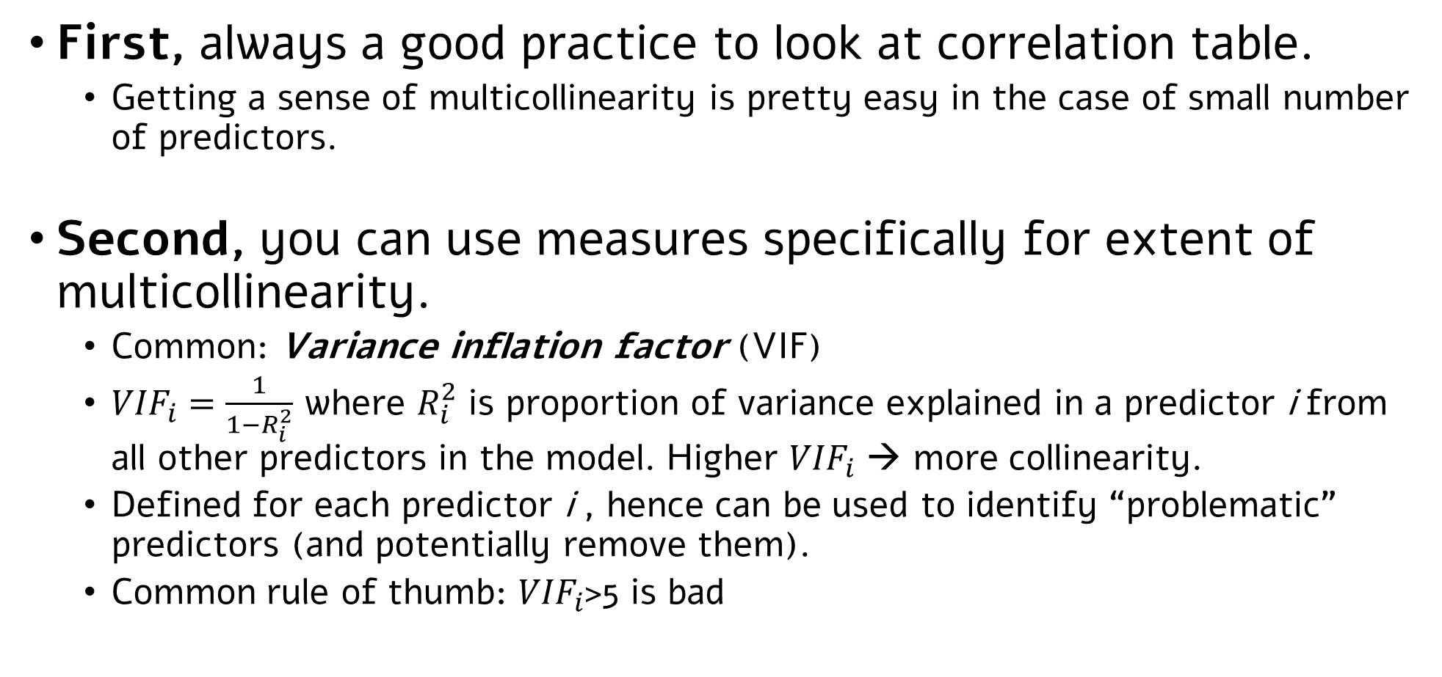
Measures of multicollinearity
First, always a good practice to look at correlation table.
Getting a sense of multicollinearity is pretty easy in the case of small number of predictors.
Second, you can use measures specifically for extent of multicollinearity.
Common: Variance inflation factor (VIF)
${VIF}_{i}=\frac{1}{1−R_{i}^{2}}$ where $R_{i}^{2}$ is proportion of variance explained in a predictor i from all other predictors in the model. Higher ${VIF}_{i}$ → more collinearity.
Defined for each predictor i , hence can be used to identify “problematic” predictors (and potentially remove them).
Common rule of thumb: ${VIF}_{i}$>5 is bad
What does VIF=5 mean?

Slide 25
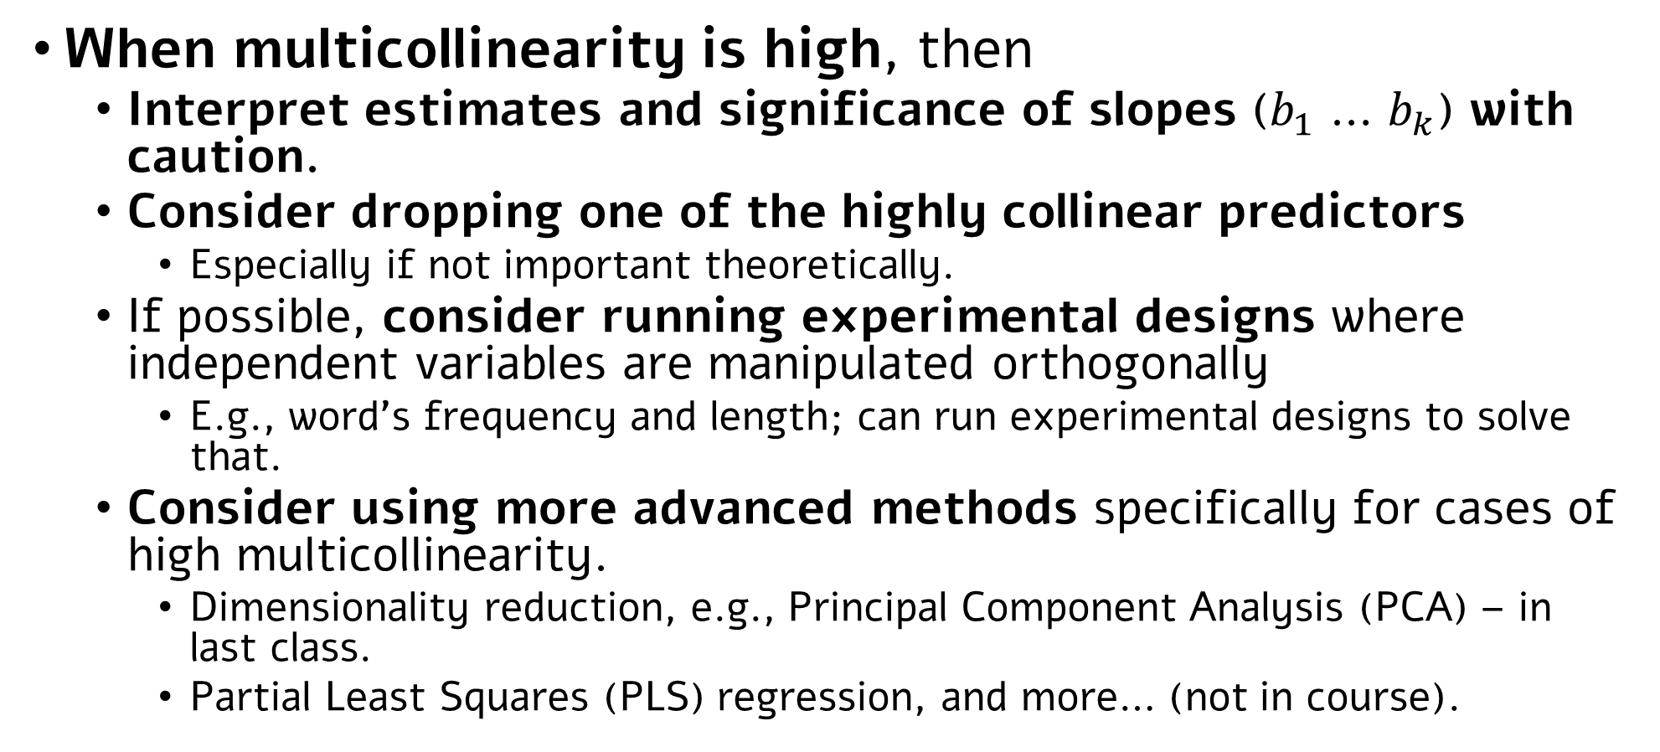
What to do in cases of high multicollinearity?
When multicollinearity is high, then
Interpret estimates and significance of slopes ($b_{1}$ … $b_{k}$) with caution.
Consider dropping one of the highly collinear predictors
Especially if not important theoretically.
If possible, consider running experimental designs where independent variables are manipulated orthogonally
E.g., word’s frequency and length; can run experimental designs to solve that.
Consider using more advanced methods specifically for cases of high multicollinearity.
Dimensionality reduction, e.g., Principal Component Analysis (PCA) – in last class.
Partial Least Squares (PLS) regression, and more… (not in course).

Slide 26
Categorical Predictors in Regression Models

Slide 27
Categorical predictors in regression models
In all regression models so far, both our predictors and outcome were continuous.
But often, we (als0) have categorical predictors we want to test.
If there’s only one categorical predictor, we can use t-test/one-way ANOVA, depending on its number of levels.
If there are two (or more) categorical predictors, we can use multi-way ANOVA.
But what should we do if there’s some combination of continuous and categorical predictors?
The answer: coding of categorical variables + regression model.

Slide 28

Example: back to happiness
In addition to our continuous predictors (exercise hours, sun exposure), we are interested in the effect of having a pet on happiness levels.
A three-level categorical variable: dog, cat, none.

Slide 29
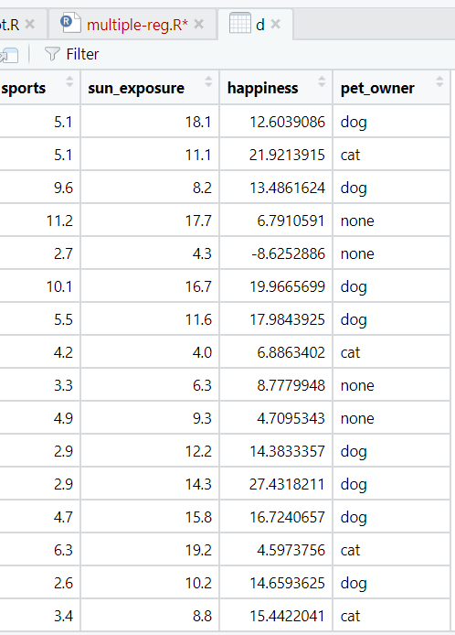
How can we add a categorical variable to a (mathematical) regression model?
The answer: Coding.
Use a “coding scheme” to transform categories of a variable to numbers.
The exact scheme used impacts interpretation of coefficients.
(without proof): Every categorical variable with K levels can be coded using K-1 numeric variables
Together, these K-1 variables reflect the total variance explained by this variable.

Slide 30
Dummy coding (aka treatment coding)
Like in all coding schemes, for a three-level variable, we will use two (K-1) “dummy” variables.
We choose one level as baseline, and assign 0 values in all dummy variables.
 | Var1 | Var2
No pet | 0 | 0
Cat
Dog

Slide 31
Dummy coding (aka treatment coding)
Like in all coding schemes, for a three-level variable, we will use two (K-1) “dummy” variables.
We choose one level as baseline, and assign 0 values in all dummy variables.
Other levels are assigned 1’s in one variable, and 0’s in all others.
 | Var1 | Var2
No pet | 0 | 0
Cat
Dog

Slide 32
Dummy coding (aka treatment coding)
Like in all coding schemes, for a three-level variable, we will use two (K-1) “dummy” variables.
We choose one level as baseline, and assign 0 values in all dummy variables.
Other levels are assigned 1’s in one variable, and 0’s in all others.
 | Var1 | Var2
No pet | 0 | 0
Cat | 1 | 0
Dog | 0 | 1

Slide 33
Dummy coding (aka treatment coding)
An extension to 4-level categorical variable
 | Var1 | Var2 | Var3
Level 1 (set as baseline) | 0 | 0 | 0
Level 2 | 1 | 0 | 0
Level 3 | 0 | 1 | 0
Level 4 | 0 | 0 | 1
What about a categorical variable with two levels?

Slide 34
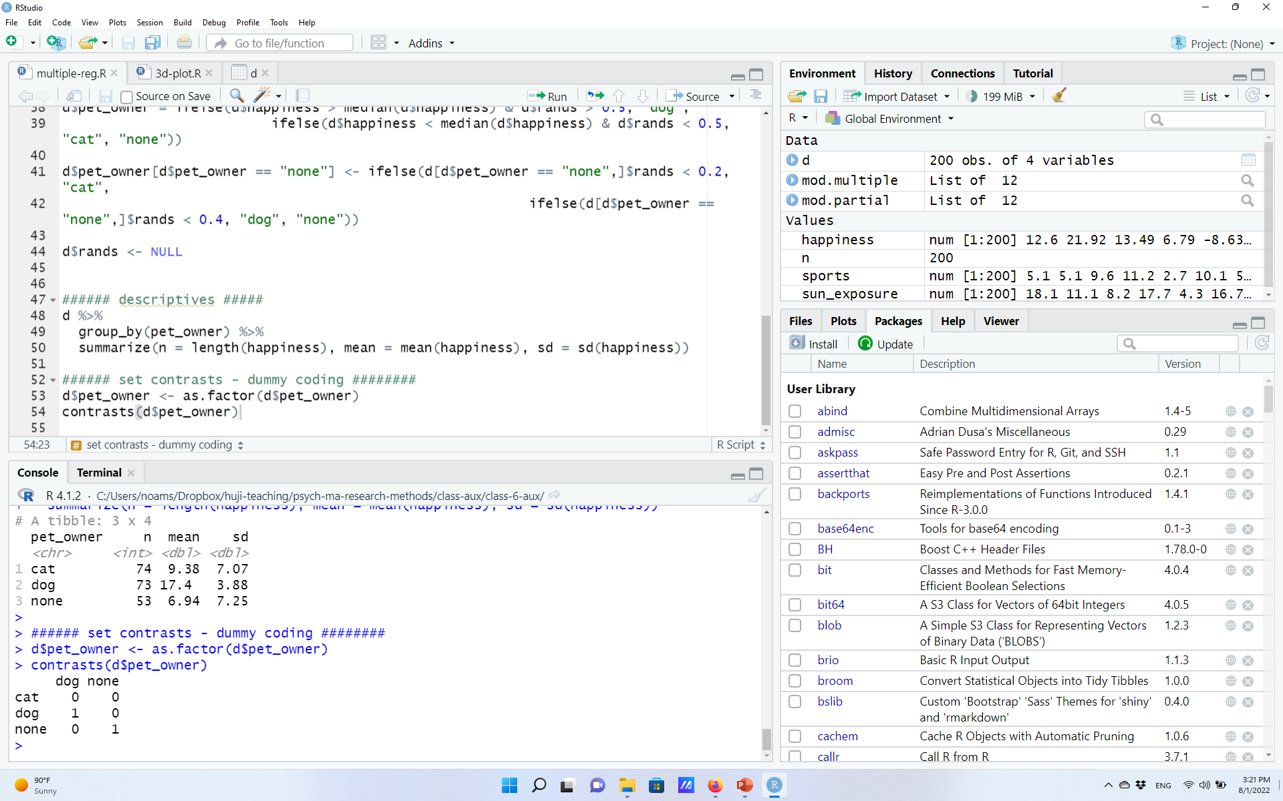
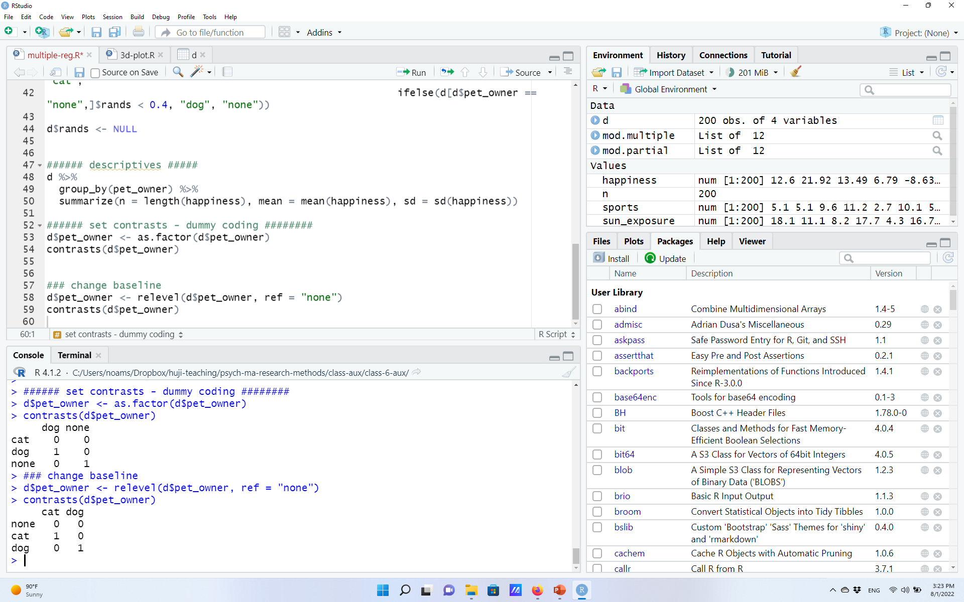
Dummy coding (aka treatment coding) in R
In R, categorical variables should be saved as ‘factors’.
Factors by default have a coding, which can be accessed using the function contrasts().
The default in R is dummy coding!
(probably a problematic choice for a default – we’ll see why next week…)
R automatically treats the first (alphabetically) row as the baseline.
Can be changed, e.g., by “relevel”-ing the factor.

Slide 35
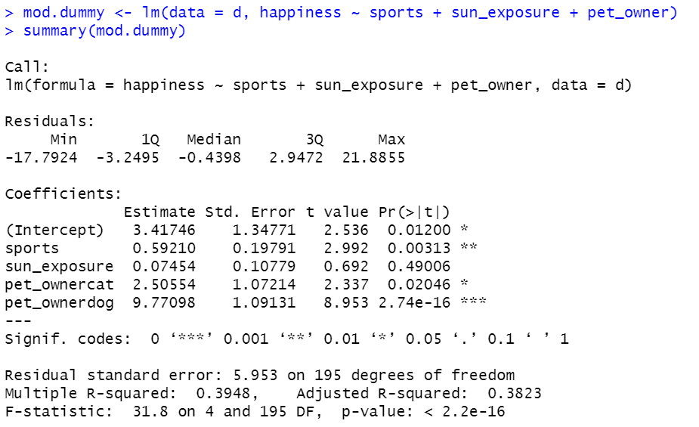
Linear model with dummy-coded variables: Interpretation
We get estimates for two coefficients – one for each dummy variable we used.
The first: ‘pet_ownercat’:
The estimated difference between the level ‘cat’ and the baseline (=no pets)*.
The second: ‘pet_ownerdog’:
The estimated difference between the level ‘dog’ and the baseline (=no pets).
Each has its b, SE, t, and p-value.
Sometimes of interest, sometimes less so.
(Why is it that dummy coding the estimates are the difference between each level and baseline? This requires some math. Interested? See here)

Slide 36
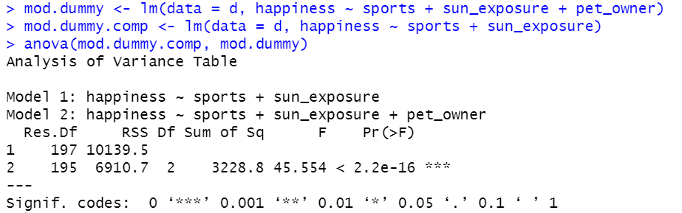
Testing the overall effect of the categorical predictor
How to test the overall effect of pet ownership on happiness?
Use the F-based test for nested model comparison!
Ideas for what would be a good effect size estimate for this comparison?

Slide 37
Effect coding (aka sum coding)
 | Var1 | Var2
No pet | -1 | -1
Cat
Dog
In effect coding, one level gets (-1) in all variables
typically, the baseline / least interesting level.

Slide 38
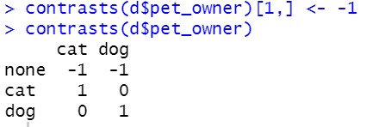
Effect coding (aka sum coding)
 | Var1 | Var2
No pet | -1 | -1
Cat | 1 | 0
Dog | 0 | 1
In effect coding, one level gets (-1) in all variables
typically, the baseline / least interesting level.
The other levels get (1) in one variable each, and 0 in other variables.
In R:
What about a categorical variable with two levels? Four levels?

Slide 39
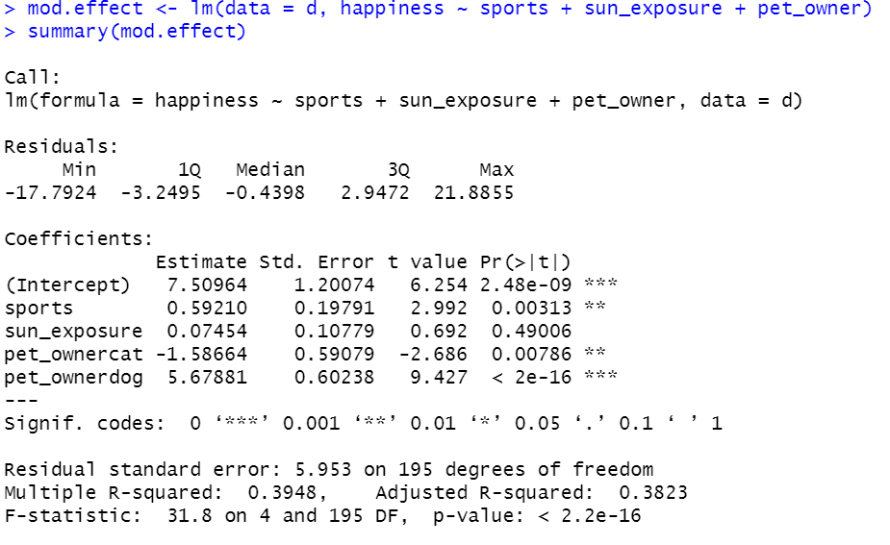
Linear model with effect-coded variables: Interpretation
We still get two estimates (=K-1), but their interpretation is now different*: The coefficient reflects the difference between the level and the grand mean.
‘pet_ownercat’:
The estimated difference between the level ‘cat’ and the grand mean.
‘pet_ownerdog’:
The estimated difference between the level ‘dog’ and the grand mean.
(*Again, this requires some math – see same link as above).

Slide 40
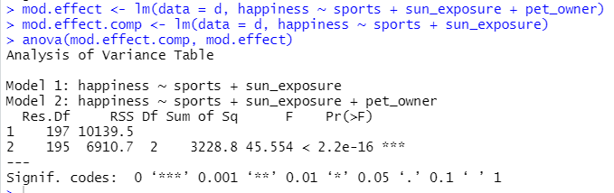
Testing the overall effect of the categorical predictor
Running a model comparison, we will get the exact same results as in the dummy coding
The overall effect of a variable does not change as a function of whether we used dummy- or effect-coding.
In both cases, the K-1 variables together reflect the overall influence of the variable.

Slide 41
Categorical variable coding: Two notes
Although dummy- and effect-coding are by far the most common, there are multiple other coding schemes.
If relevant, see, e.g., here.
Although at this point you may think that choosing a coding scheme is not that important, often, it is crucial.
Especially: When the model includes interactions: Next week…

Slide 42
Regression vs. ANOVA Back to the General Linear Model (GLM)

Slide 43
Regression, ANOVA, and the General Linear Model
Now that we know how to code categorical variables, we can use a regression instead of an ANOVA to test of an effect of even a single categorical variable.
Cities and depression levels:
Nashville (4) | Seattle (3) | Los Angeles (2) | New York City (1)
1 3 6 1 8 4 0 12 8 7 | 12 14 4 10 15 8 7 5 9 16 | 3 4 6 8 12 14 5 9 6 3 | 6 7 11 12 7 9 13 4 18 3

Slide 44
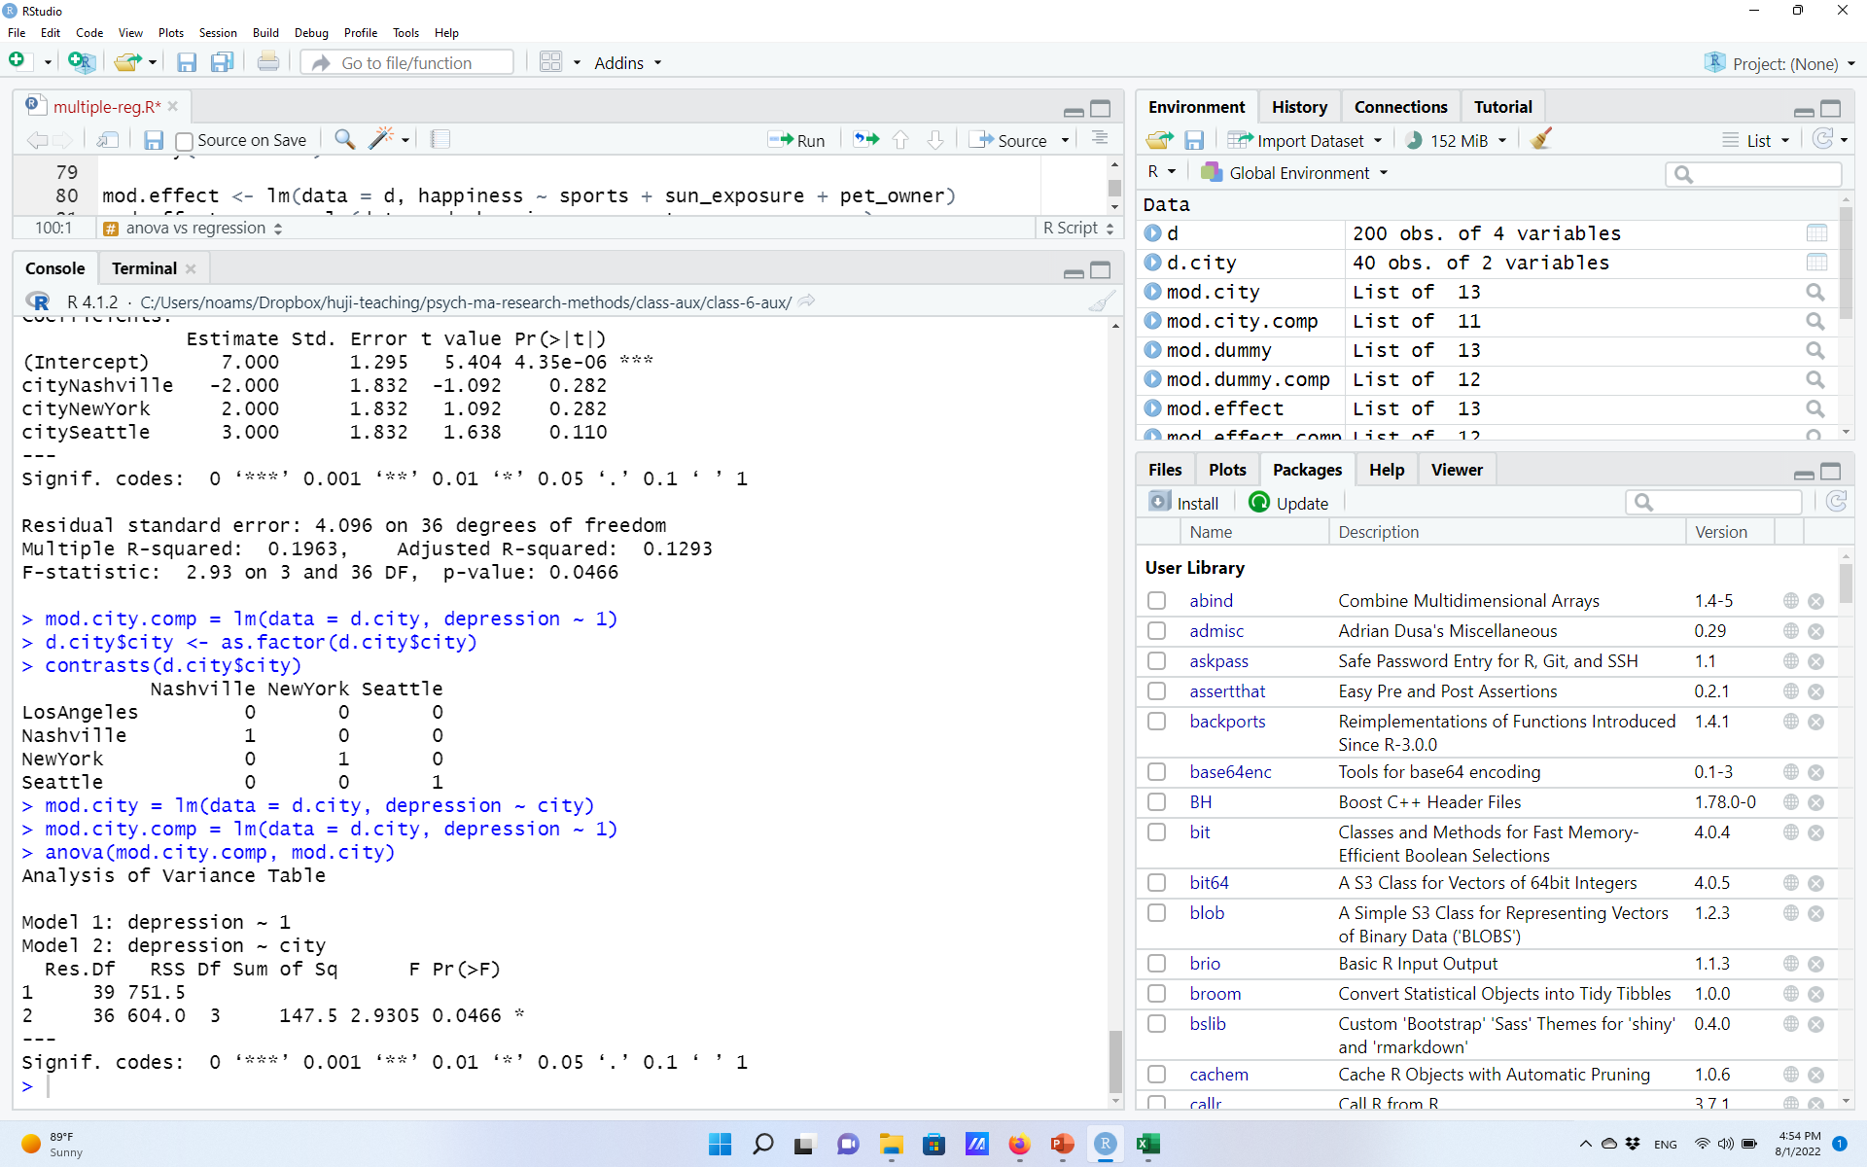
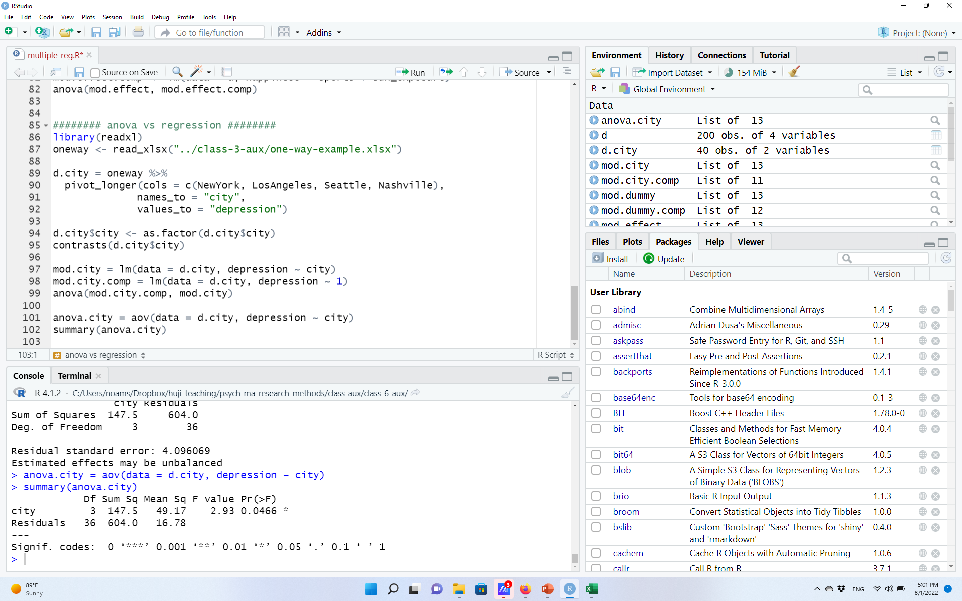
Regression, ANOVA, and the General Linear Model
Coding the variable “city”, and running a simple linear regression + model comparison
Equivalent to a one-way ANOVA:

Slide 45
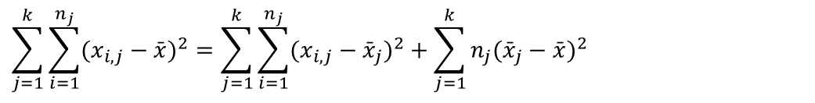
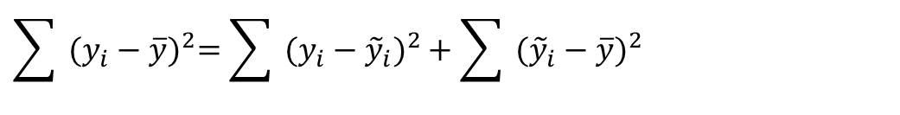
The reason? Regression and ANOVA are both based on the General Linear Model (GLM) principles
In both approaches, we dissect the total sum square errors to systematic (“between”, “regression”) and random (“within”, “error”) components. In the case of a single categorical predictor, these are the same thing!
In Regression:
In ANOVA:
$$\sum{{ (y_{i}−\overline{y})}^{2}=\sum{{ (y_{i}−{\tilde{y}}_{i})}^{2}}+\sum{{ ({\tilde{y}}_{i}−\overline{y})}^{2}}}$$
Sum of Squares
Total (SST)
Sum of Squares Errors (SSE)
Sum of Squares Regression (SSreg)
$$\sum_{j=1}^{k}{\sum_{i=1}^{n_{j}}{(x_{i,j}−\bar{x})^{2}}}=\sum_{j=1}^{k}{\sum_{i=1}^{n_{j}}{(x_{i,j}−{\bar{x}}_{j})^{2}+\sum_{j=1}^{k}{n_{j}({\bar{x}}_{j}−\bar{x})^{2}}}}$$
Sum of Squares
Total (SST)
Sum of Squares Within (SSW)
Sum of Squares Between (SSB)

Slide 46
The reason? Regression and ANOVA are both based on the General Linear Model (GLM) principles
One-way (between-subject) ANOVA is a specific case of the GLM, where we have one categorical variable with K levels.
Two-sample t-test is an even more specific case, when K=2.
Two-way and (X-way) ANOVA are also specific cases, where we test the impact of two (or X) categorical variables and their interactions: we’ll see how exactly next week.
Regression models and ANOVAs employs the same principles.
Splitting deviations in the DV to “explained” and “unexplained/residuals”.
Regression encompasses all models we saw so far for the analysis of between-subject data (i.e., independent observations), which are specific cases of the GLM
Within-subject data – where observations are dependent – requires another tool, in a couple of weeks…
Regression is more flexible – can handle many additional cases
Combination of continuous and categorical predictors,
Unbalanced designs (cf. two-way ANOVA),
And more: next week…

Slide 47
So why not just use regression instead of ANOVA/t-test?
Frankly: you can.
The popularity of t-test/ANOVAs is mostly sociological, IMO.
Everyone’s familiar with them.
Doesn’t require coding of variables.
Although sometimes, due to previous methodological developments, it’s easier to work within an ANOVAs framework.
The distinction between planned and post-hoc comparisons is well-defined in the ANOVA framework and corrections are available.
Also, ANOVAs offer parallel tests for between- and within-subject data analysis, which weren’t available until relatively recently in the regression framework.

Slide 48
Mediation Analysis If times allows

Slide 49
Back to the happiness example
We know that happiness is correlated with both sun exposure and sport activity.
Our dataframe:
We also know that sporting activity has an effect beyond hours of sun exposure.
Notes:
Exercise hours is correlated with happiness, but it is also correlated with sun_exposure, so it’s hard to say whether it’s impact is unique or not.

Slide 50
Back to the happiness example
In (simple) mediation analysis we ask whether and how much of an effect of an independent variable on a dependent variable is mediated (i.e., explained) by a third variable.
In our example, whether and how much of the effect of physical activity on happiness…
Physical activity
happiness
Independent/”treatment” (X)
Outcome (Y)
Is explained by the third (control) variable, sun exposure.
Mediator
Sun exposure
Indirect effect
Physical activity
happiness
Direct effect
Independent/”treatment” (X)
Outcome (Y)
Notes:
Exercise hours is correlated with happiness, but it is also correlated with sun_exposure, so it’s hard to say whether it’s impact is unique or not.

Slide 51
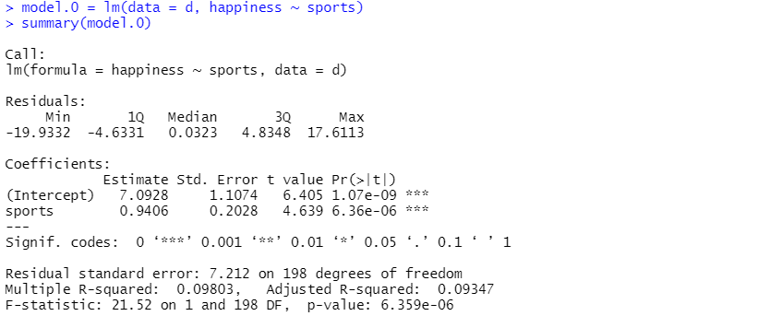
Mediation analysis steps
Sun exposure
Physical activity
happiness
“Step 0”: Not a formal part of the model, but useful to establish that indeed there’s a link between y and x.
Notes:
Exercise hours is correlated with happiness, but it is also correlated with sun_exposure, so it’s hard to say whether it’s impact is unique or not.

Slide 52
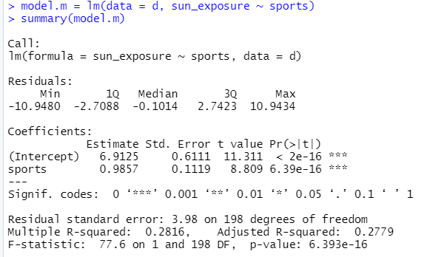
Mediation analysis steps
Sun exposure
Physical activity
happiness
“Step M”: Check the strength of the link between X (independent) and M (mediator)
Notes:
Exercise hours is correlated with happiness, but it is also correlated with sun_exposure, so it’s hard to say whether it’s impact is unique or not.

Slide 53
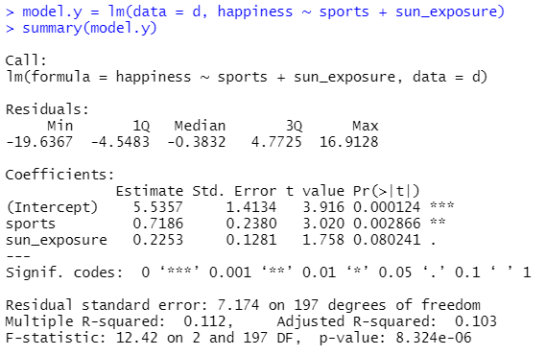
Mediation analysis steps
Sun exposure
Physical activity
happiness
“Step Y”: Check the strength of the link between X (independent) and Y (outcome), while also controlling for M (mediator)
Notes:
Exercise hours is correlated with happiness, but it is also correlated with sun_exposure, so it’s hard to say whether it’s impact is unique or not.

Slide 54
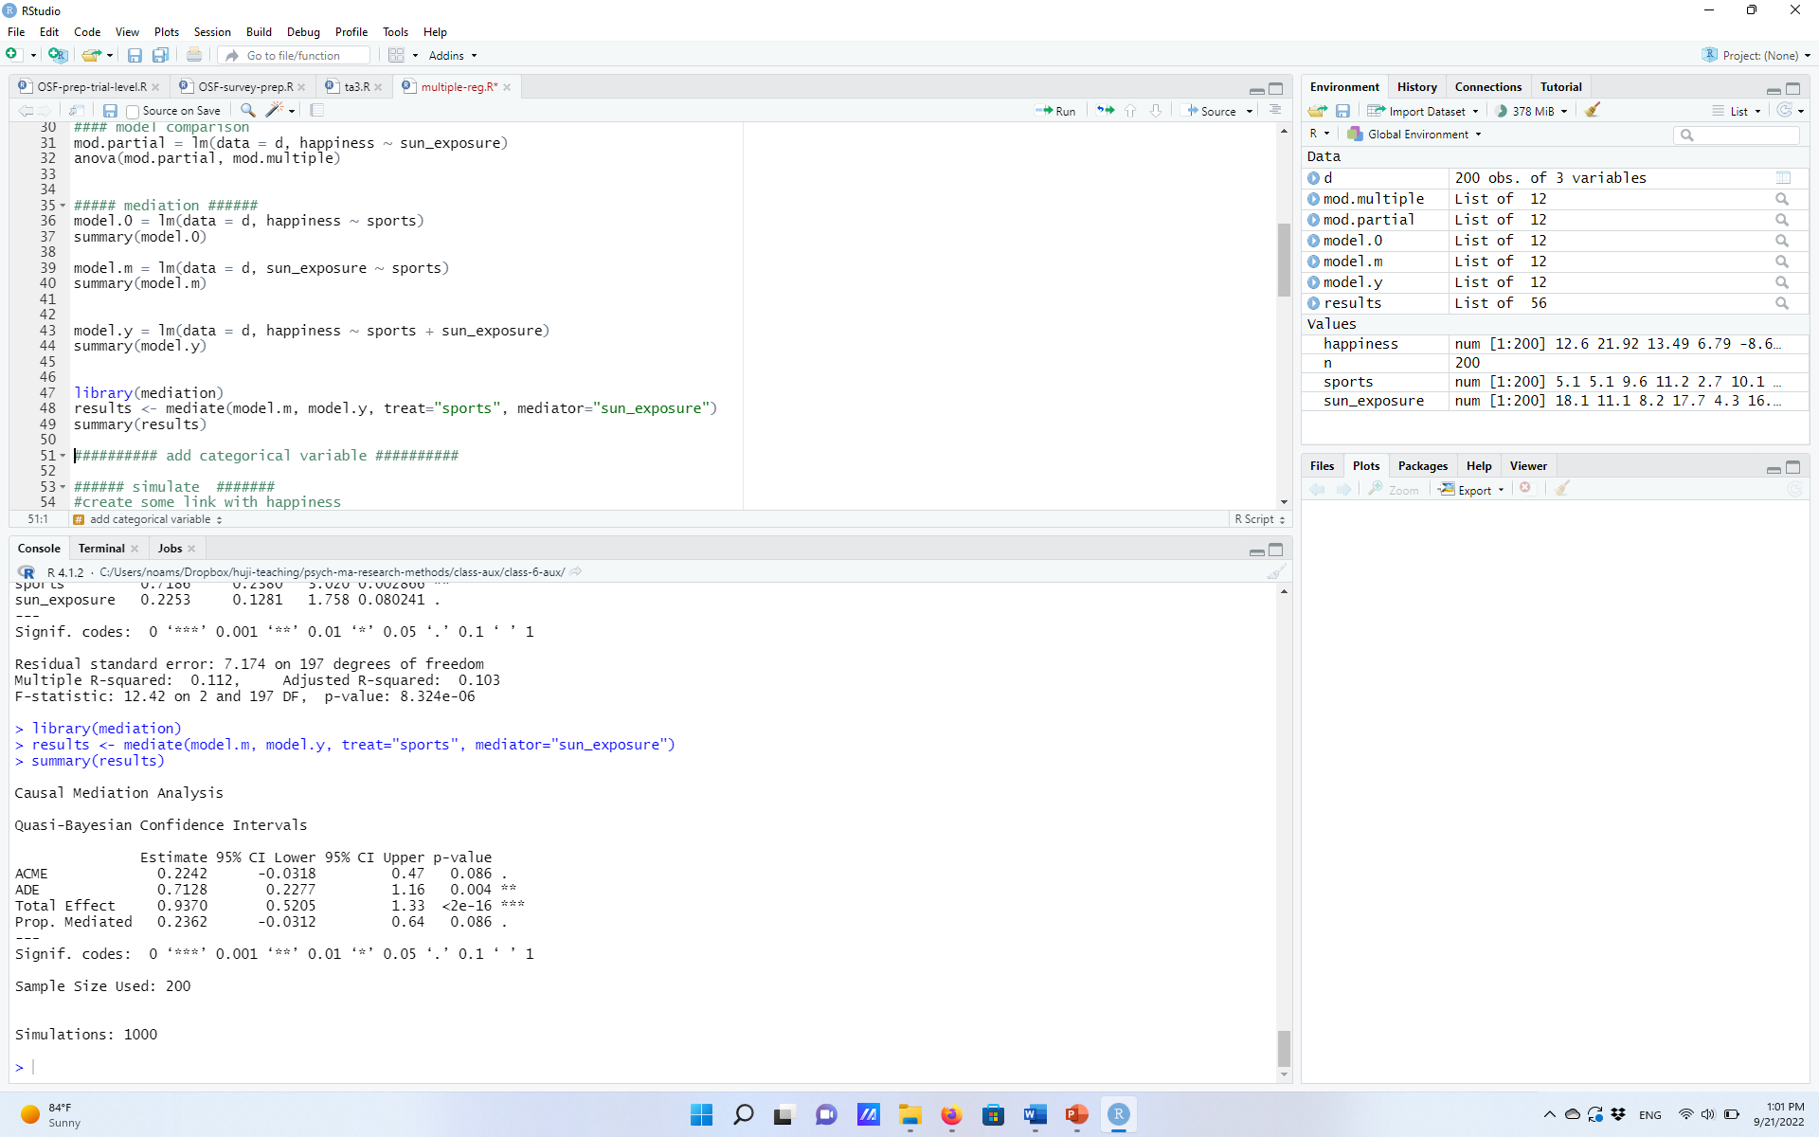
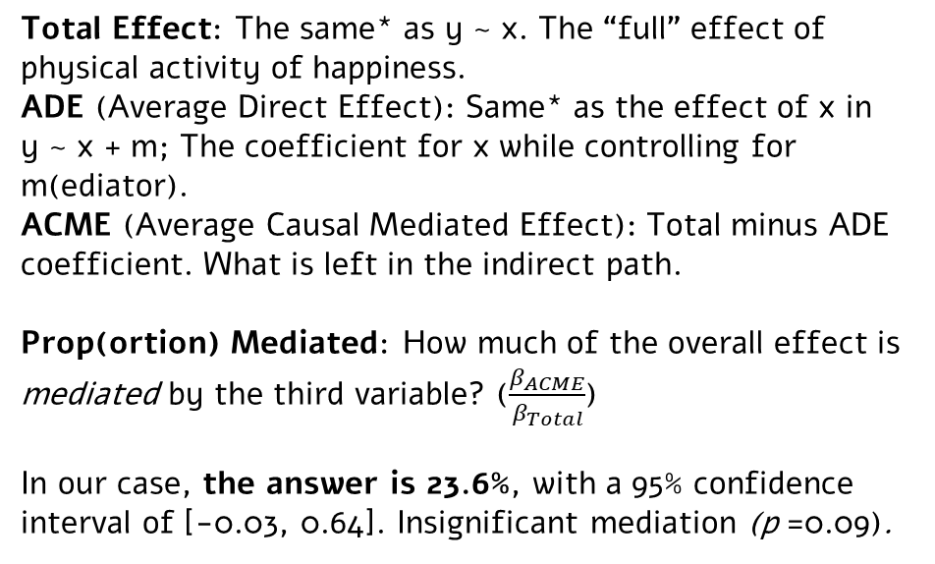
Mediation analysis steps
Sun exposure
M
Physical activity
happiness
X
Y
Lastly, run the mediation, to compare variable associated with direct vs. indirect paths.
Total Effect: The same* as y ~ x. The “full” effect of physical activity of happiness.
ADE (Average Direct Effect): Same* as the effect of x in y ~ x + m; The coefficient for x while controlling for m(ediator).
ACME (Average Causal Mediated Effect): Total minus ADE coefficient. What is left in the indirect path.
Prop(ortion) Mediated: How much of the overall effect is mediated by the third variable? ($\frac{β_{ACME}}{β_{Total}}$)
In our case, the answer is 23.6%, with a 95% confidence interval of [-0.03, 0.64]. Insignificant mediation (p =0.09).
* Some small numeric differences given fitting methods; not crucial for our purposes.
Notes:
Exercise hours is correlated with happiness, but it is also correlated with sun_exposure, so it’s hard to say whether it’s impact is unique or not.

Slide 55
Two technical Notes
1) Final Assignment + Presentations.
The goal: apply what you’ve learned (and will learn) in class on your own data or in the context of your research.
General structure: Take a dataset that was previously analyzed with a “classic” test, describe how, repeat the procedure, answer some questions. Then, identify potential issues, propose possible solutions, apply via mixed-effect models.
Less simulations/made-up data, more dealing with real-world challenges.
Modular – can start early, continue as we learn more tools.
First, need to submit data for our approval (“Part 0”)
Final submission date: 28/02/2023 (in pairs).
Short presentations: 8 minutes (+4 discussion). Present dataset, previous analysis, potential problems, and possible solutions. Meant to help you.
Two dates: last class (24/1/2023) or two weeks post-semester (07/02/2023).

Slide 56
Two technical Notes
2) New! “R doesn’t work” Q&A Forum
Stuck with R? Code doesn’t work? Not sure what function to use? Technical R issues?
Ask via the new “R doesn’t work” Forum on Moodle.
Then, fellow students answer questions (we will not intervene).
Top 3 helpful students will get a bonus to final grade: 3 points.
(Assuming a reasonable number of questions asked).

